Slide 1

Hate speech detection
Ajith Murugaian (E20003)
Harsha Chinnamulagund (E20011)
James Ajeeth (E20013)
Mohammed Arshan Khan (E20015)

Slide 2
Overview
Problem Statement
Objective
Methodology
A) Data Extraction and Labeling
B) Data Processing
C) Model Building and Results
Challenges Faced
Demonstration of the Product
Conclusion

Slide 3
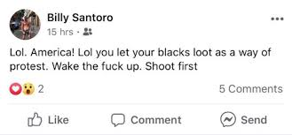
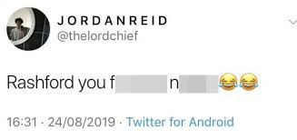
Problem STATEMENT
Twitter in recent years has become a cesspool of racism and hate comments. Minority groups, celebrities, sports personalities are all targets of abuse on a regular basis.
Is there a way to overcome this problem so that twitter becomes a safe place for everyone again?

Slide 4
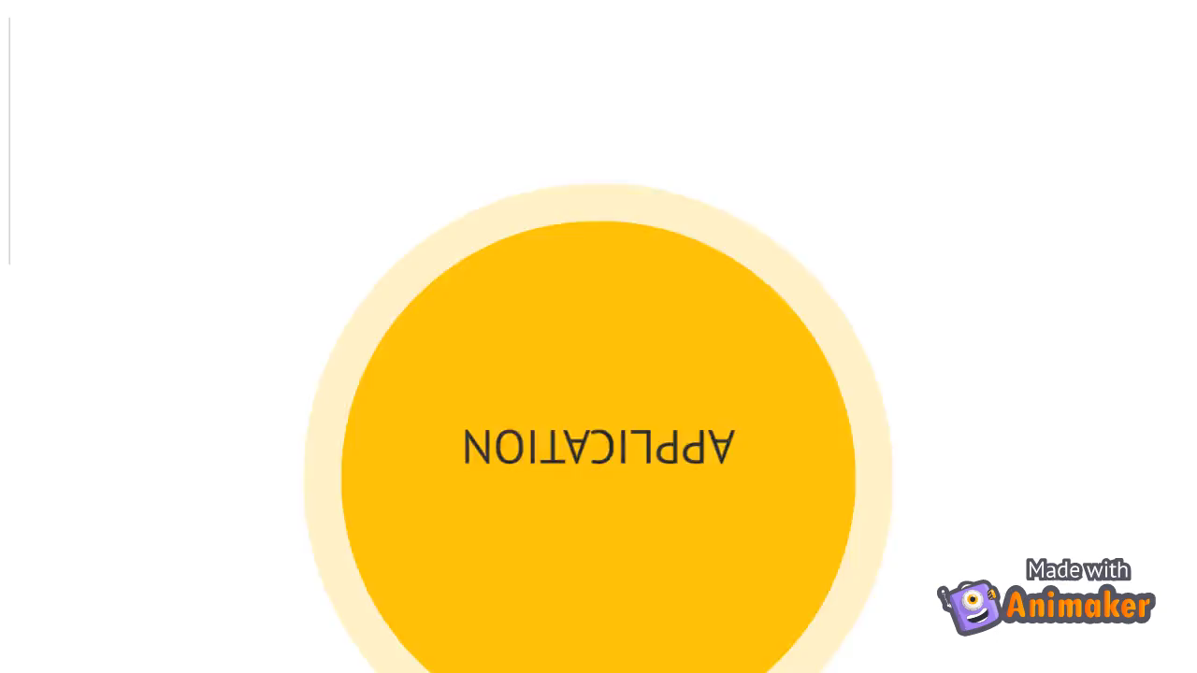
Objective of the project
Our objective is to design an application that helps us to overcome the problem of hate speech.
Our application has 3 features
Allows us to view a filtered clean version of twitter without hate comments
Find if a particular tweet is offensive
Find if a particular user is racist and an option to report them.

Slide 5
methodology
DATA EXTRACTION
Over 3000 English tweets were extracted from Twitter using 2 methods
Through user timelines
Through trending hashtags
Most of the offensive tweets were collected through user timeline since explicitly searching for particular offensive hashtags would make the model biased towards those words.
For other languages, we used pre collected data from various sources.
The languages we were able to get data for were French, Danish, Greek, Arabic, Turkish, Indonesian and Hindi.

Slide 6
methodology
DATA LABELLING
Everyone’s definition of offensive or not varies. So we created the following rule set to label our data.
Fuck has become a very commonly used word in online slang. We shouldn’t label a tweet as offensive just because it contains the word. We need to look at the word following fuck too.
Tweets containing words like bitch, whore, nigger are offensive no matter what the context is.
Sometimes, words in isolation may not be offensive but as a whole it might be offensive. Eg. I hate gays/ I hate black people.
Stop words shouldn’t be removed. They can change the meaning of a sentence. Eg: You are a monkey – offensive; you have a monkey – non offensive.
Death threats – offensive
Racism towards a particular community – Jews, blacks, gays is offensive.

Slide 7
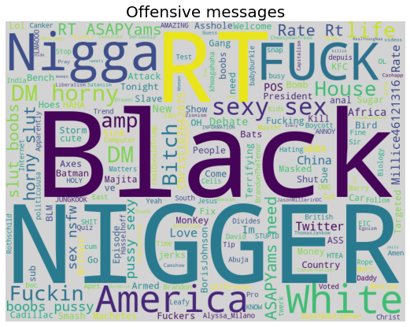
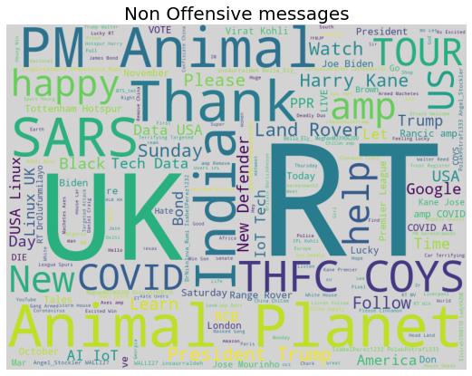
methodology
Word Clouds on offensive and non offensive tweets

Slide 8
Data Preprocessing
1. Remove Twitter Handles @username
2. Remove https links
3. Remove hashtags of length >6
4. Convert text to lower case
5. Remove Emoticons
6. Convert internet slang words to proper verbal form

Slide 9
Process flow
Tweet
Data Pre-processing
Feature Extraction
Language Detection
Offensive Tweet Classifier (EN)
Offensive Tweet Classifier (FR)
Offensive Tweet Classifier (GR)
Offensive Tweet Classifier (HI)
Off
Not
Off
Not
Off
Not
Off
Not

Slide 10
Model building
After pre-processing, Feature Extraction was done using tf-idf vectorization with word n-grams.
Language Detection
First we used Langdetect, a python package ported from Google language detection library. We didn’t get good results using it as we are working with only 8 languages as our target label values, whereas Langdetect tries to predict having 55 different languages as its target values.
The Naïve Bayes model we used was able to deliver good results with an accuracy of 94%.
Offensive or Not Classifier
For some of the languages, data was imbalanced. So we had to do balancing of data before fitting the model.
Separate models was built for each language.
Based on the output of language detection model, the tweet was sent to the appropriate language model.

Slide 11
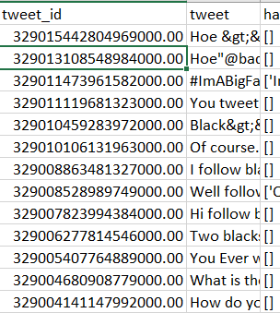
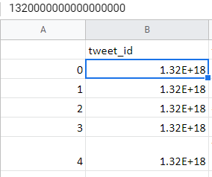
Challenges faced
In Excel
There is a lot of offensive content in the replies section of each tweet. Our scope initially included both tweets and replies. But we ran into some problems extracting the replies.
Tweet ids are 14+ digits long. We used Google sheet to store all our extracted tweets. What we did not realize was Google sheets approximated all tweet ids as first 3 digits followed by all 0s.
Luckily, we had backup of 80% of the data. So using that we tried to extract the replies for the tweet ids. But Twitter API has a hard rate limit. As soon as we exceed that rate limit, it temporarily suspends us from accessing any of its end points. We were going beyond the limit for every 5 tweets or so. It would be impossible to extract replies for 4000 tweets going at that rate.
Due to these issues, we had to change our project scope and decided to go with only tweets, but taking other languages tweets also into consideration.
In Google Sheets

Slide 12


Demonstration of our product

Slide 13
FUTURE SCOPE
In this project, we have considered 8 languages. We aim to add more languages in the future.
Offensive images have to be considered. We have to see if it’s possible to read the captions written in images if any.
Experiment on other social media platforms like Instagram or Facebook.
Optimise the model so that the time to output can be reduced.

Slide 14
Questions

